Slide 1
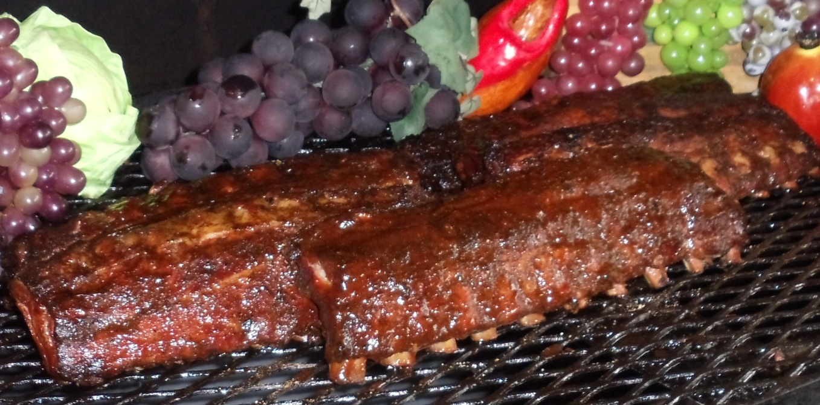

Boy Scout Troop 48
Germantown, Tenn.
www.Troop48.org
Cooked by the Serial Grillers who took 1st place in Ribs in the 2015 Memphis in May World Championship Barbeque Cooking Contest.
Boston Pork Roast and Smoked Ribs Fundraiser
$40 per Roast.
$25.00 per slab.
$8.00 for sauce.
These are the ribs that won first place.
Roasts are 8 to 9 lb. average pre-cooked weight; enough for up to 18 sandwiches.
We accept cash and checks made payable to Boy Scout Troop #48.
Order due with money by June 25th. (Form on reverse.) Pick up on July 4th
from 10 a.m. to Noon at Faith Presbyterian Church in Germantown. (See Web site for map and directions.)
More information? Contact Richard Ralph at: Raintekirrigation@gmail.com

Slide 2
